Slide 1

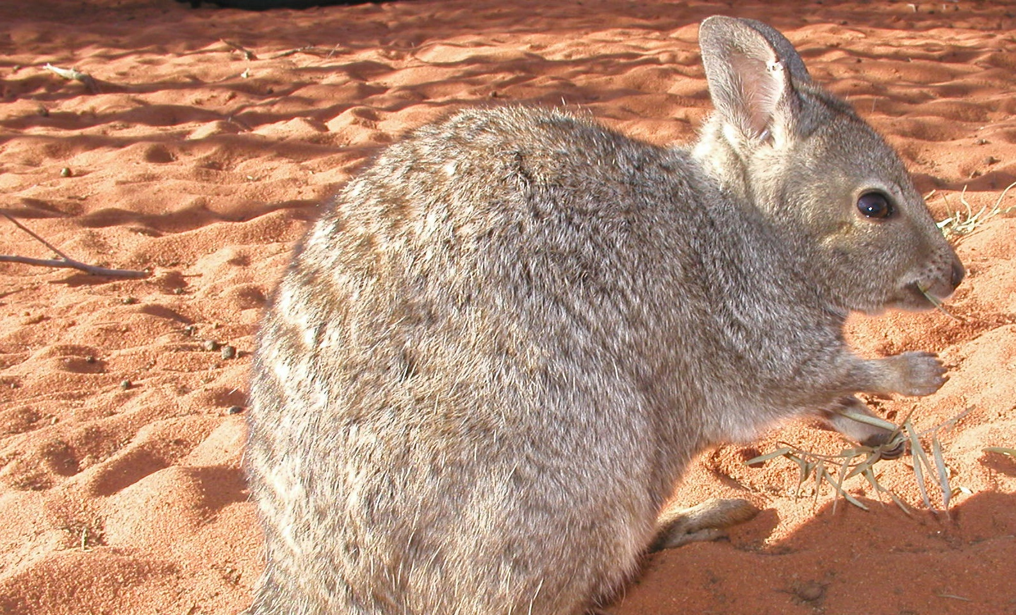
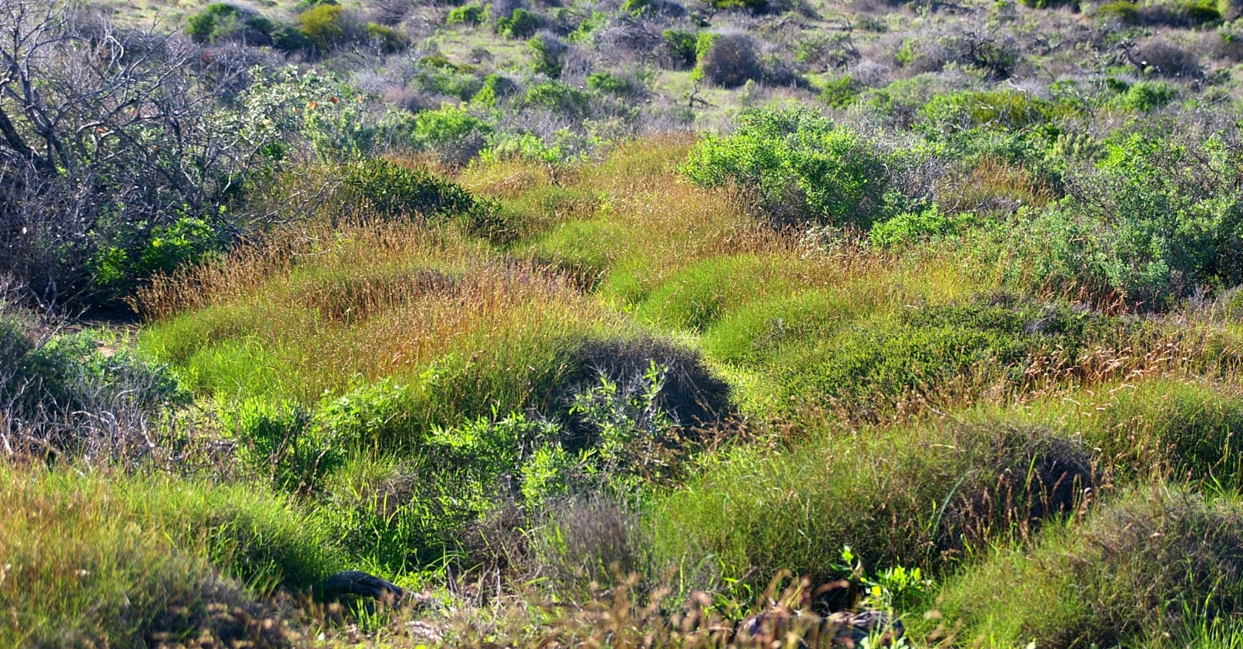
Inquiry Project
Knowledge Construction
Dirk Hartog Island National Park Return to 1616 Ecological Restoration Project
This project challenges you to be a researcher! Do you feel you have a strong understanding of biodiversity in the Shark Bay region? What would you like to know? Who would you like to share this information with to make a positive impact?

Slide 2
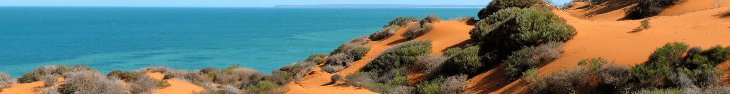
Return to 1616
Knowledge Construction Project
Dirk Hartog Island National Park Return to 1616 Ecological Restoration Project
Your quest, should you choose to accept…
This project challenges you to be a researcher! It will help you to learn all about the animals being relocated to Dirk Hartog Island and why. It will challenge you to think about what you would like to know. Who could you share your research with to make a positive impact?
Having an opportunity to generate your own questions for a topic can dramatically enrich learning. This project is designed to engage you in a quality process to conduct meaningful research. Just make sure you work closely with your teacher/parents if you need help with difficult research questions. Most importantly, make time at the end to share, celebrate and reflect your learning with others, no matter how big or small.
Step 1
What do you know about the animals being returned to Dirk Hartog Island? What would you like to know?
Step 2
Use Information Fluency to lead you through a meaningful research process.
Step 3
Share and celebrate!

Slide 3
Return to 1616
Knowledge Construction Project
Dirk Hartog Island National Park Return to 1616 Ecological Restoration Project
Ideas for research
Twelve mammal species and one bird species are being translocated onto Dirk Hartog Island. Many of these species are threatened with extinction and listed on the Australian Government’s list of nationally threatened species. Select one of the animal species to research and use the Information Fluency inquiry method to lead you through.
Brush-tailed mulgara
Banded hare-wallaby
Boodie
Chuditch
Desert mouse
Dibbler
Shark Bay bandicoot
Heath mouse
Western grasswren
Greater stick-nest rat
Woylie
Shark Bay mouse
Rufous hare-wallaby
Extension Ideas
These ideas come from the Australian Curriculum, Cross-Curriculum Priorities, Sustainability. Use Information Fluency to help you unpack and research these ideas in relation to the Dirk Hartog Island Return to 1616 Ecological Restoration Project.
Systems
All life forms, including human life, are connected through ecosystems on which they depend for their wellbeing and survival.
Sustainable patterns of living rely on the interdependence of healthy social, economic and ecological systems.
World Views
World views that recognise the dependence of living things on healthy ecosystems, and value diversity, are essential for achieving sustainability.
World views are formed by experiences at personal, local, national and global levels, and are linked to individual and community actions for sustainability.
Futures
The sustainability of ecological systems is achieved through informed individual and community action that values local and global equity and fairness across generations into the future.
Actions for a more sustainable future reflect values of care, respect and responsibility, and require us to explore and understand environments.
Designing action for sustainability requires an evaluation of past practices, the assessment of scientific and technological developments, and balanced judgements based on projected future economic, social and environmental impacts.
Sustainable futures result from actions designed to preserve and/or restore the quality and uniqueness of environments.
The biosphere is a dynamic system providing conditions that sustain life on Earth.

Slide 4
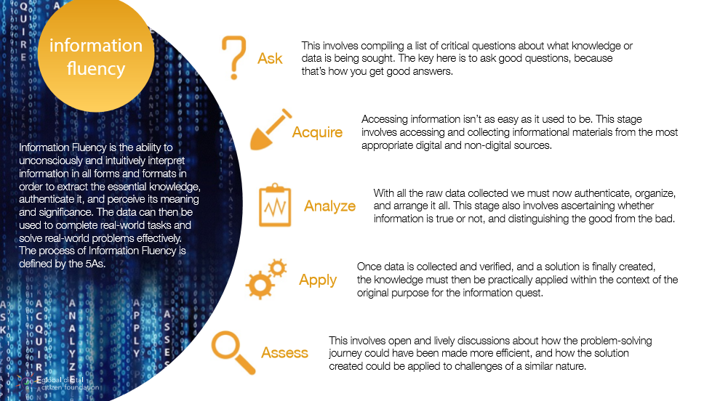
Use Information Fluency to lead the way…
Information Fluency is designed to lead you through an inquiry research process. Use the following pages to capture your learning. Work as a class, small group, individually and/or remotely and complete one or more projects as time permits.
Return to 1616
Knowledge Construction Project
Dirk Hartog Island National Park Return to 1616 Ecological Restoration Project
Information Fluency is the ability to subconsciously and intuitively interpret information in all forms and formats in order to extract the essential knowledge, authenticate it, and perceive its meaning and significance. The data can then be used to complete real-world tasks and solve real-world problems effectively. The process of Information Fluency is defined by the 5As.
How Information Fluency Leads to Rewarding Research for Learners – Wabisabi Learning

Slide 5
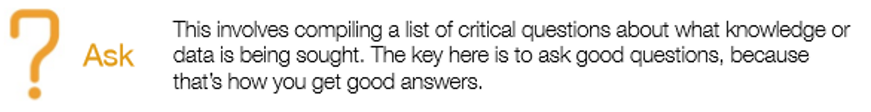

Return to 1616
Knowledge Construction Project
Dirk Hartog Island National Park Return to 1616 Ecological Restoration Project
This involves compiling a list of critical questions about what knowledge or data is being sought. The key here is to ask good questions, because that’s how you get good answers.
What would you like to know? Generate a list of good questions about one of the animals being returned as part of the Dirk Hartog Return to 1616 project.
What would you like to know? Generate a list of good questions about one of the animals being returned as part of the Dirk Hartog Return to 1616 project.
Brush-tailed mulgara
Banded hare-wallaby
Boodie
Chuditch
Desert mouse
Dibbler
Shark Bay bandicoot
Heath mouse
Western grasswren
Greater stick-nest rat
Woylie
Shark Bay mouse
Rufous hare-wallaby

Slide 6

Return to 1616
Knowledge Construction Project
Dirk Hartog Island National Park Return to 1616 Ecological Restoration Project
This stage involves accessing and collecting informational materials from the most appropriate digital and non-digital sources.
How can we find out? Use dot points to record key information from trustworthy sources.

Slide 7
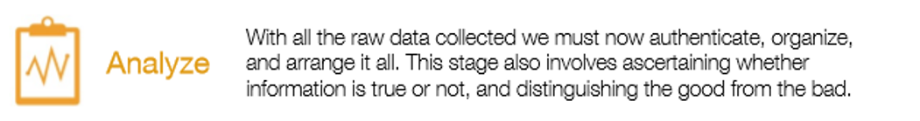
Return to 1616
Knowledge Construction Project
Dirk Hartog Island National Park Return to 1616 Ecological Restoration Project
With all the raw data collected we must now authenticate, organise and arrange it. This stage also involves ascertaining whether information is true or not, and distinguish the good from the bad.
Heading
Key points
Heading
Key points
Heading
Key points
Heading
Key points
Heading
Key points
Organize the most useful and accurate information here

Slide 8
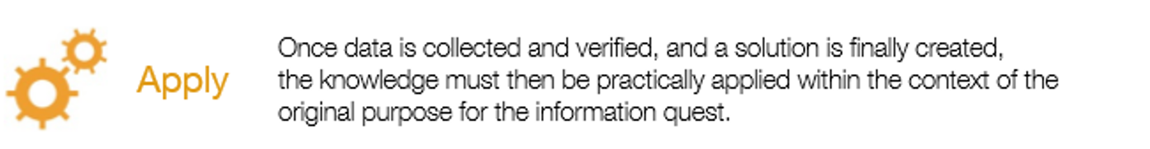
Return to 1616
Knowledge Construction Project
Dirk Hartog Island National Park Return to 1616 Ecological Restoration Project
Once data is collected and verified, and a solution is finally created, the knowledge must then be practically applied within the context of the original purpose for the information quest.
Can you put this new information to good use? How will you share your findings to best suit the purpose? Prepare your information for your target audience and share a copy here.

Slide 9

Return to 1616
Knowledge Construction Project
Dirk Hartog Island National Park Return to 1616 Ecological Restoration Project
This involves open and lively discussions about how the problem-solving journey could have been made more efficient, and how the solution created could be applied to challenges of a similar nature.
How could you have been more efficient and accurate in your research process? What aspects of the process will you use in your next research project? How did your target audience respond?
What was great?
Even better if?

